Slide 1


23rd Meeting of the Steering Committee
WMO building, 7 bis avenue de la
Paix, Geneva, Switzerland
09.45 – 11.30 CET
30 June 2026
CREWS/SC.23/infdoc.4
CREWS 2025 Annual Report Presentation
Summary
The summary of the 2025 Annual Report is presented as part of Agenda Item 2.4 on the Status of the CREWS portfolio.

Slide 2
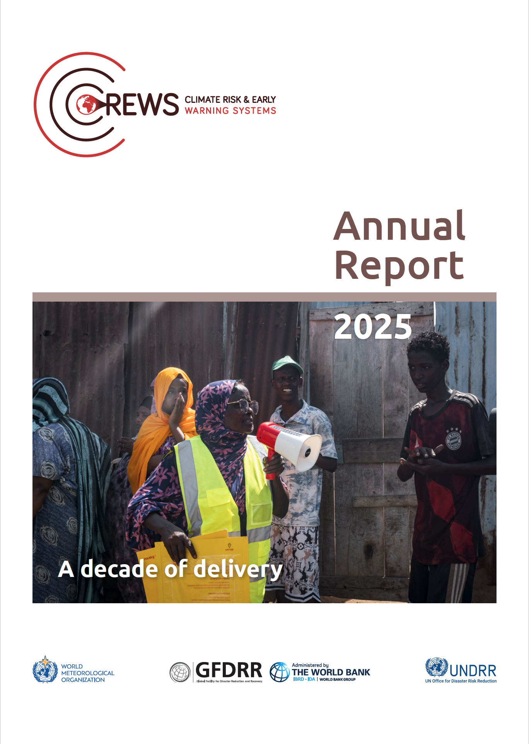
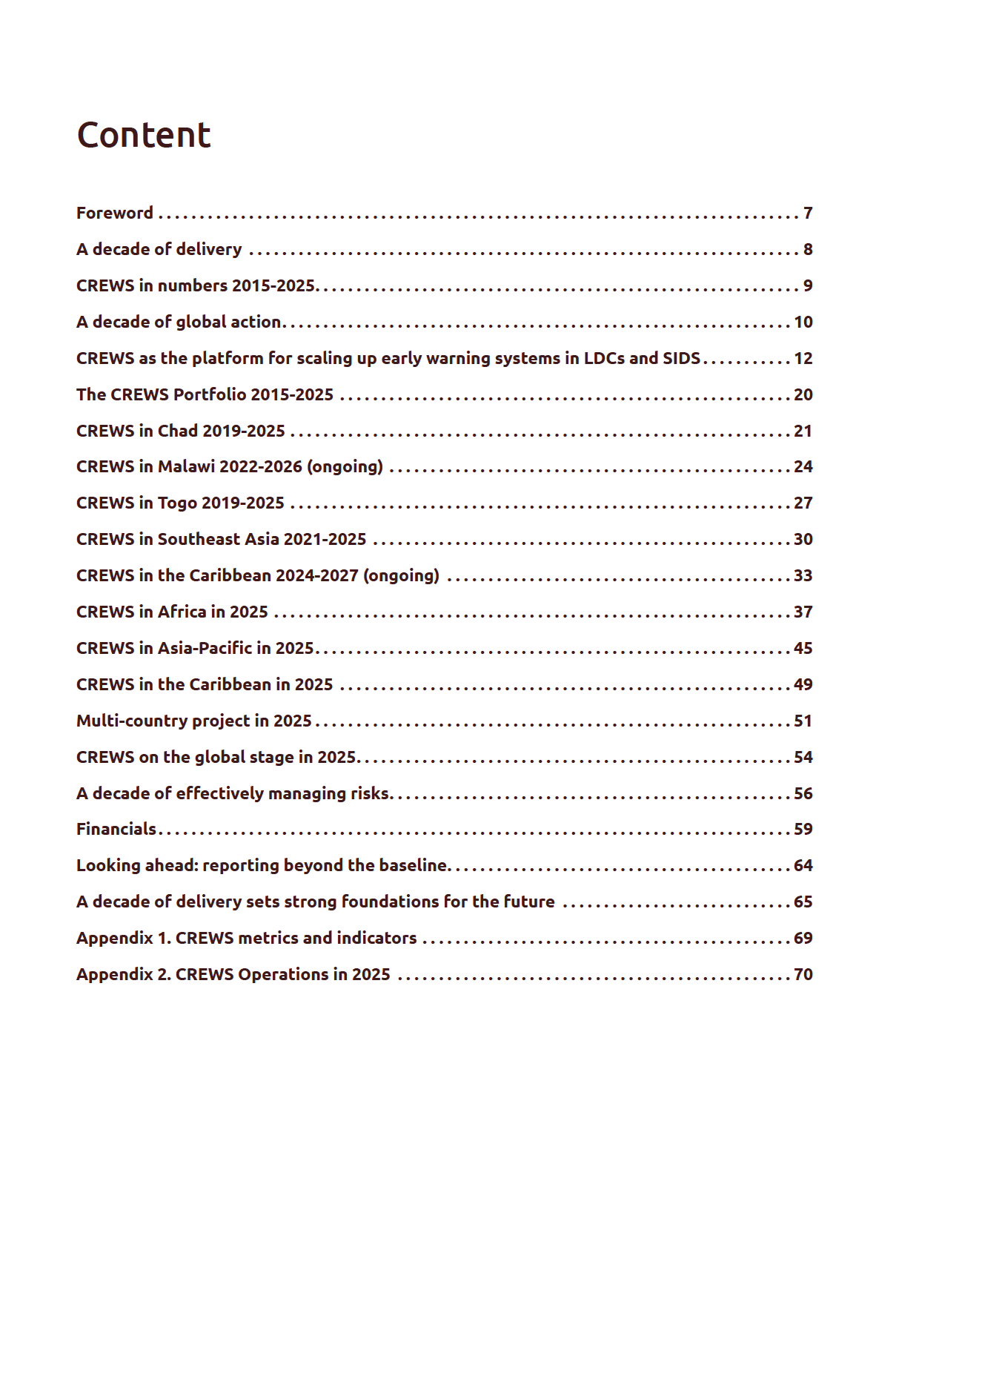
CREWS Annual Report 2025:
A decade of delivery
Celebrating a year and a decade
5 featured projects
Regionally structured portfolio overview
Focus piece on CREWS funding mechanisms

Slide 3
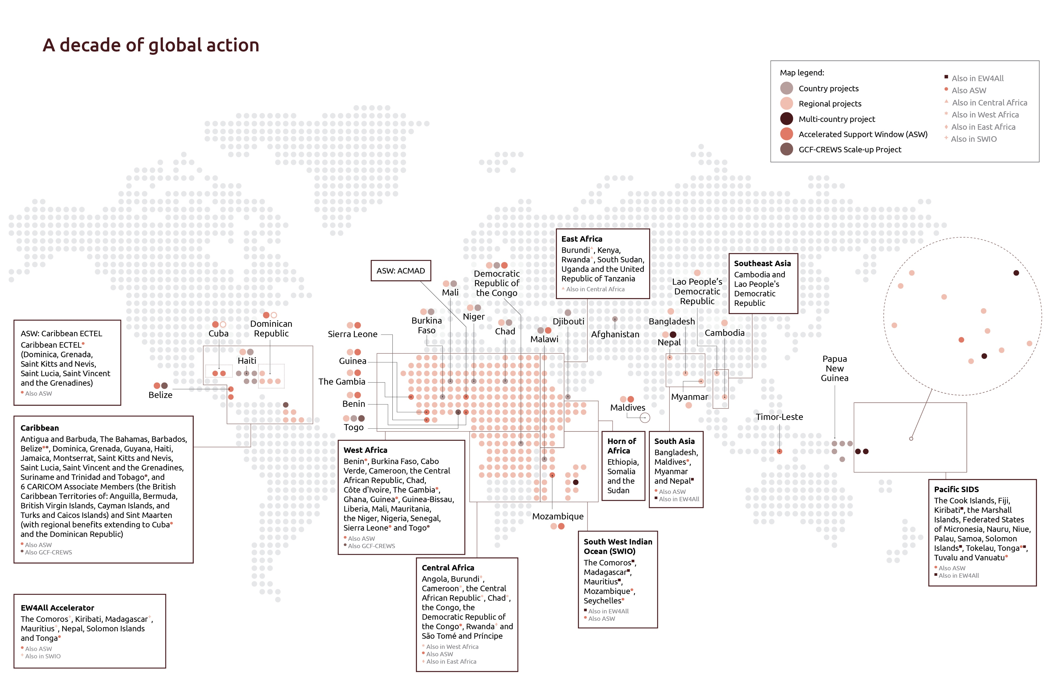

Slide 4
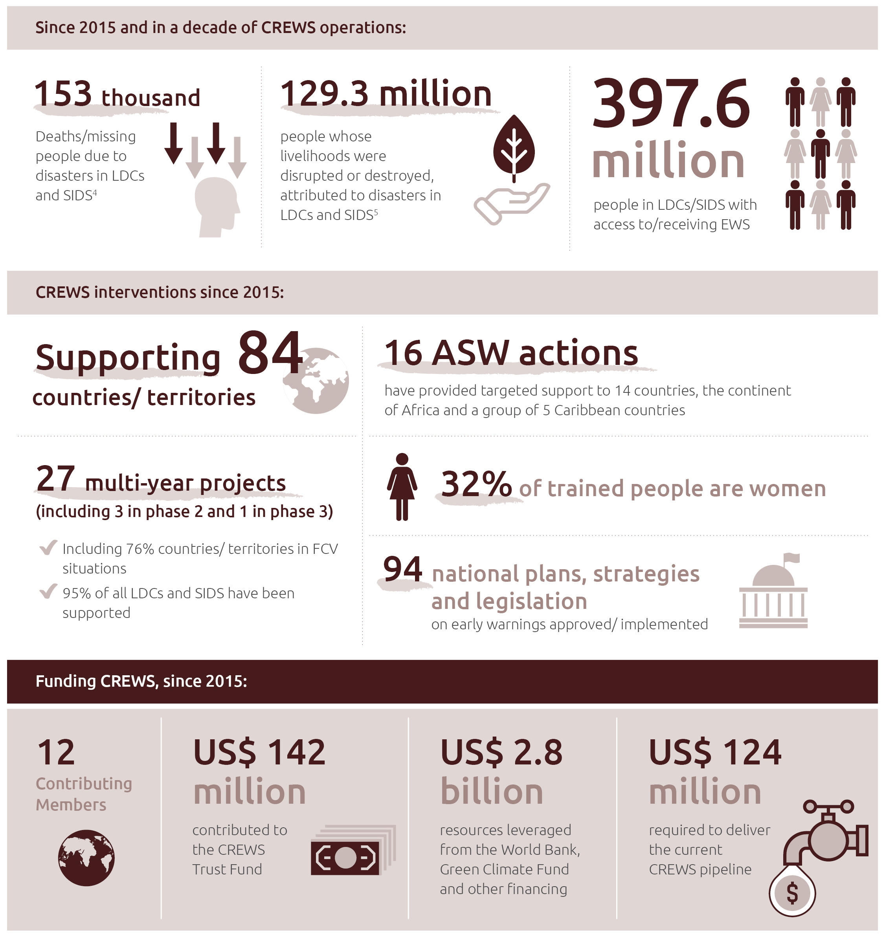
A decade of delivery

Slide 5
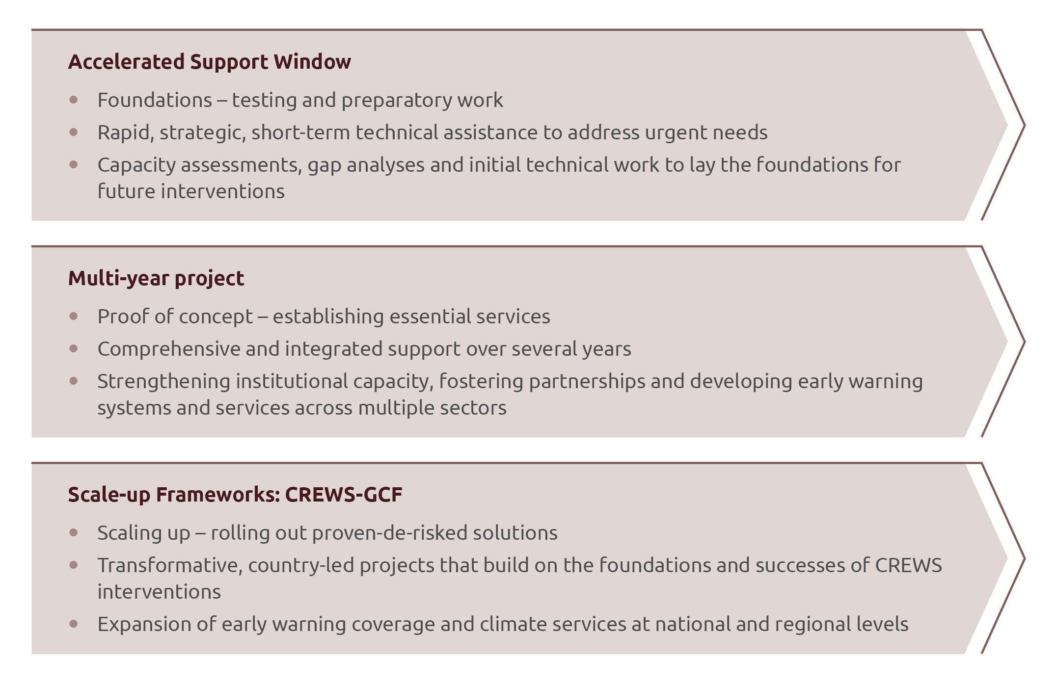
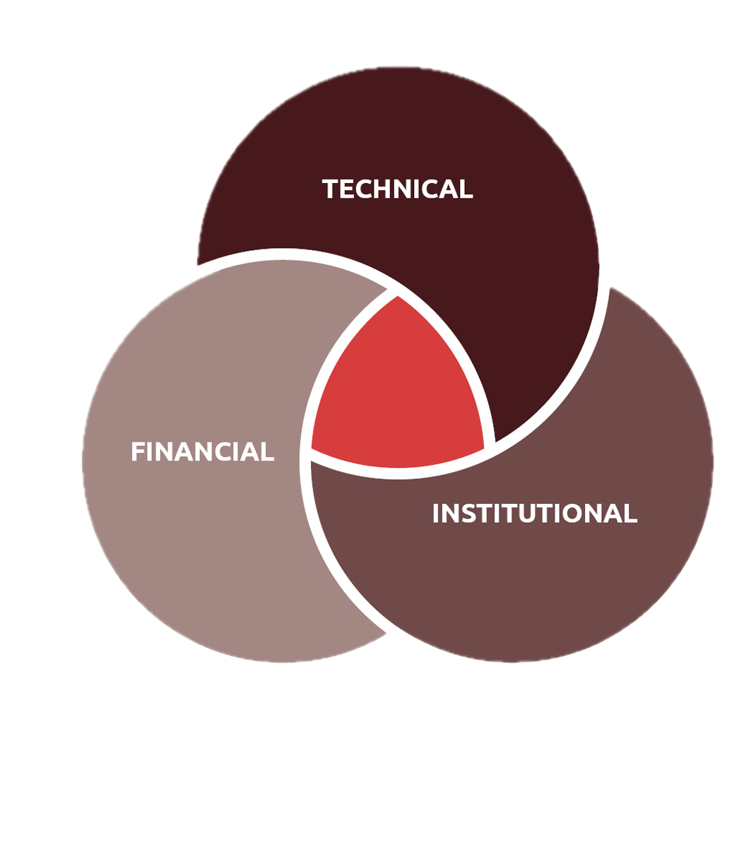
CREWS as the platform for scaling up early warning systems in LDCs and SIDS
How CREWS is transforming the climate finance landscape
CREWS’ multiple financing pathways
Beyond funding: a platform for scaling up
Enabling large-scale investment: CREWS’ de-risking mechanisms
Improving early warning in LDCs and SIDS: looking beyond 2027
Expanding CREWS’ expertise: formalising partnerships

Slide 6
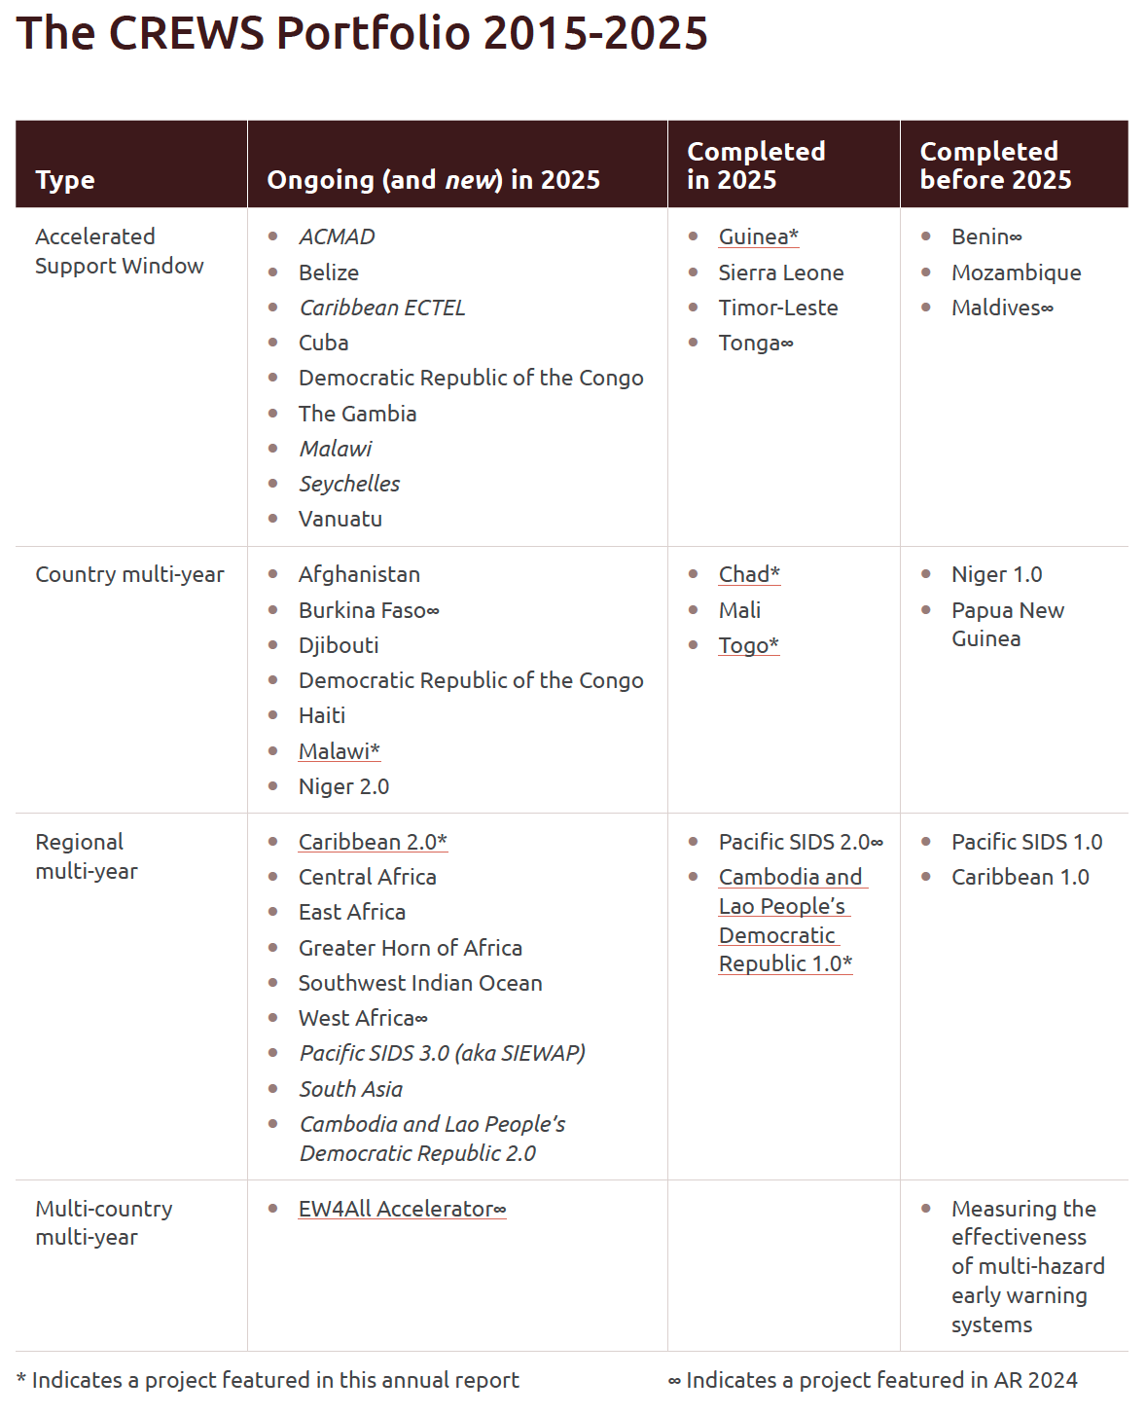
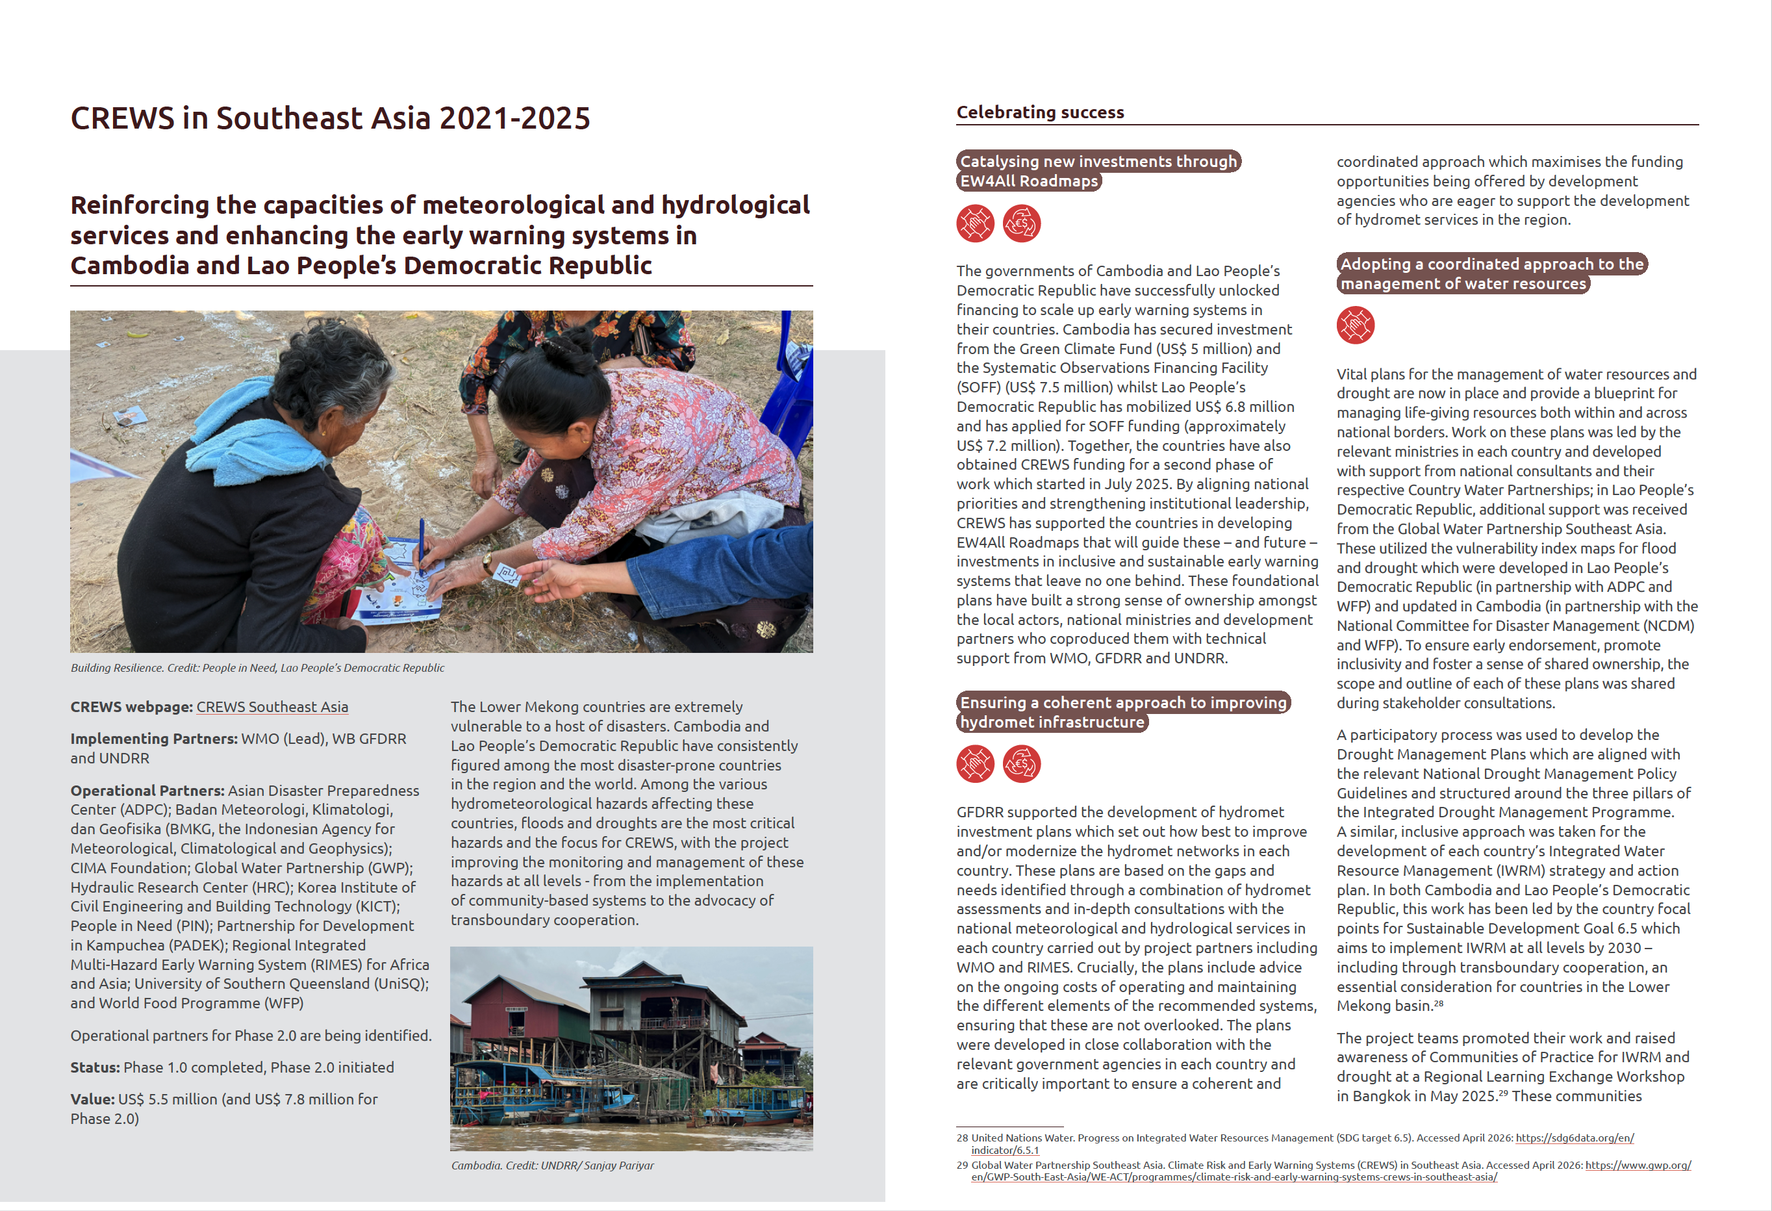
Five featured projects
Chad
Malawi
Togo
Southeast Asia
Caribbean 2.0

Slide 7

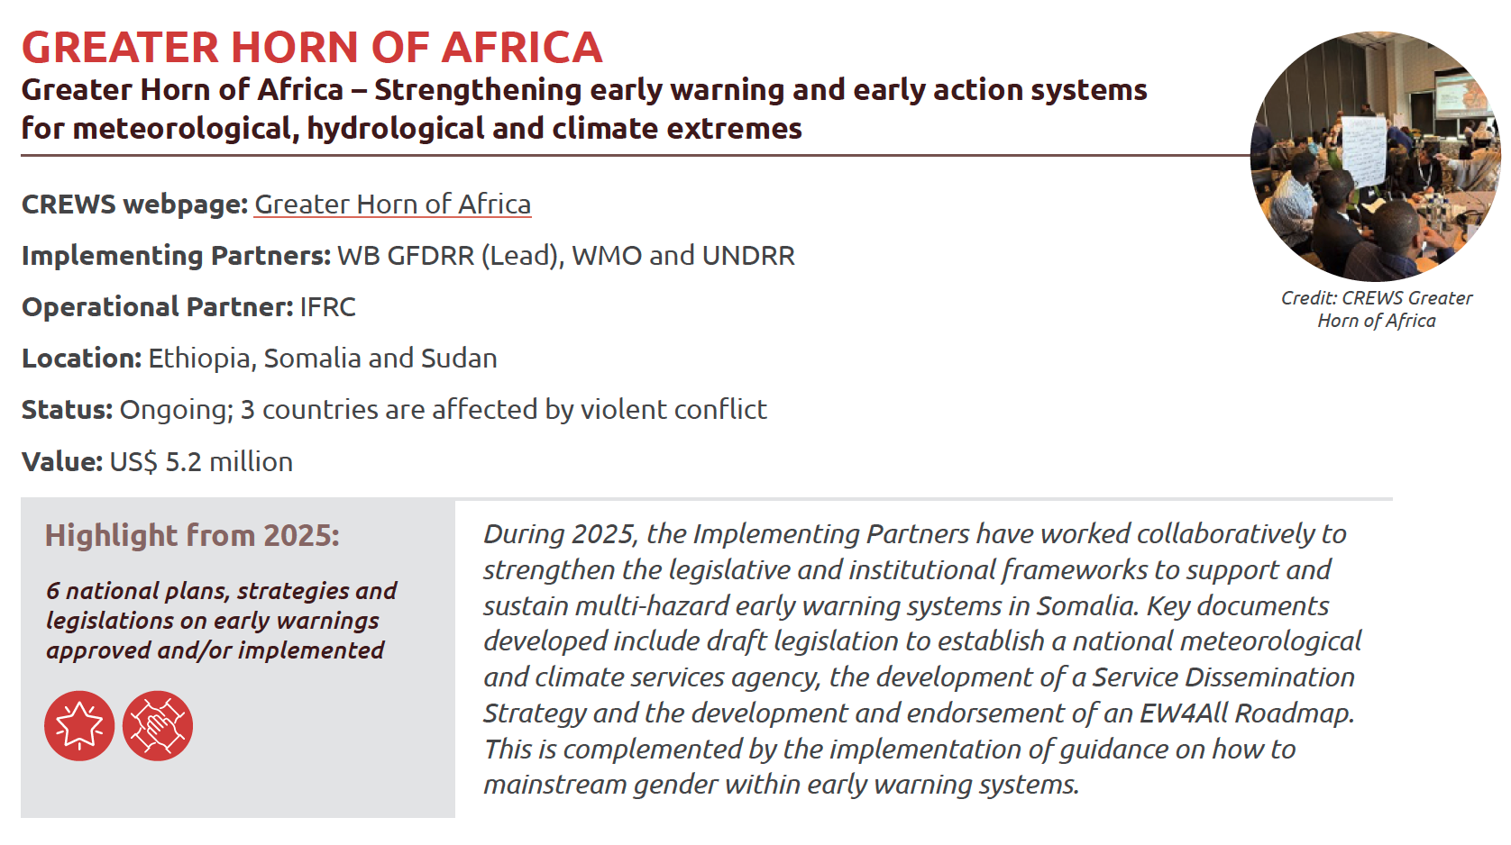
Portfolio overview – by region

Slide 8
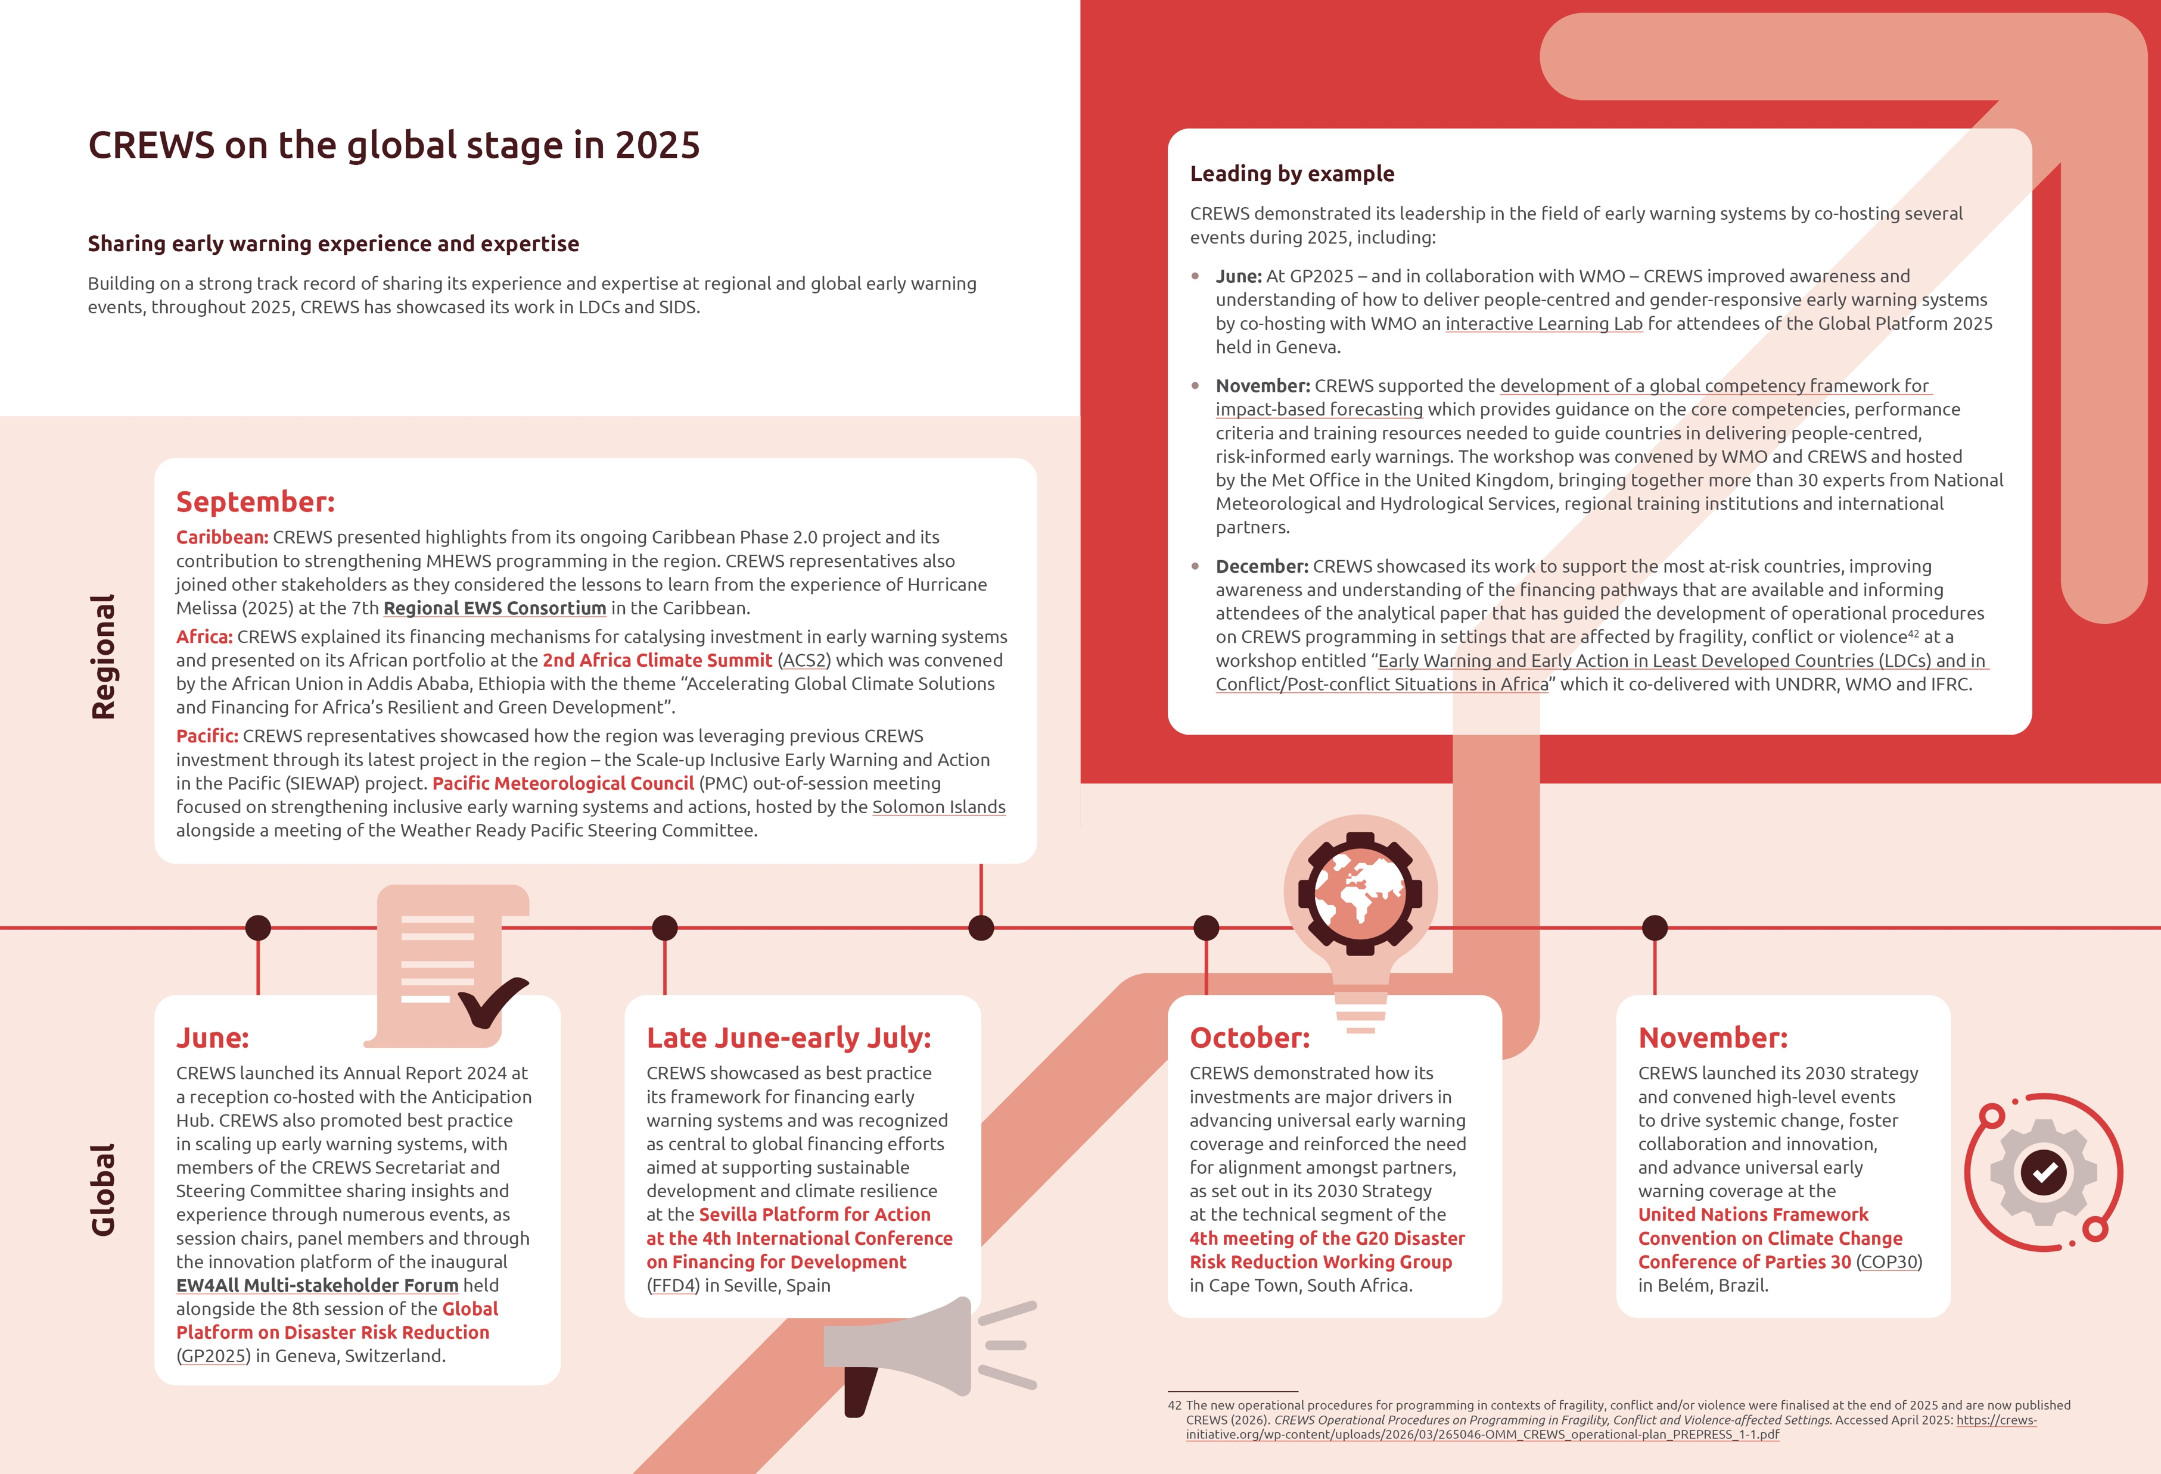
CREWS on the global stage in 2025

Slide 9
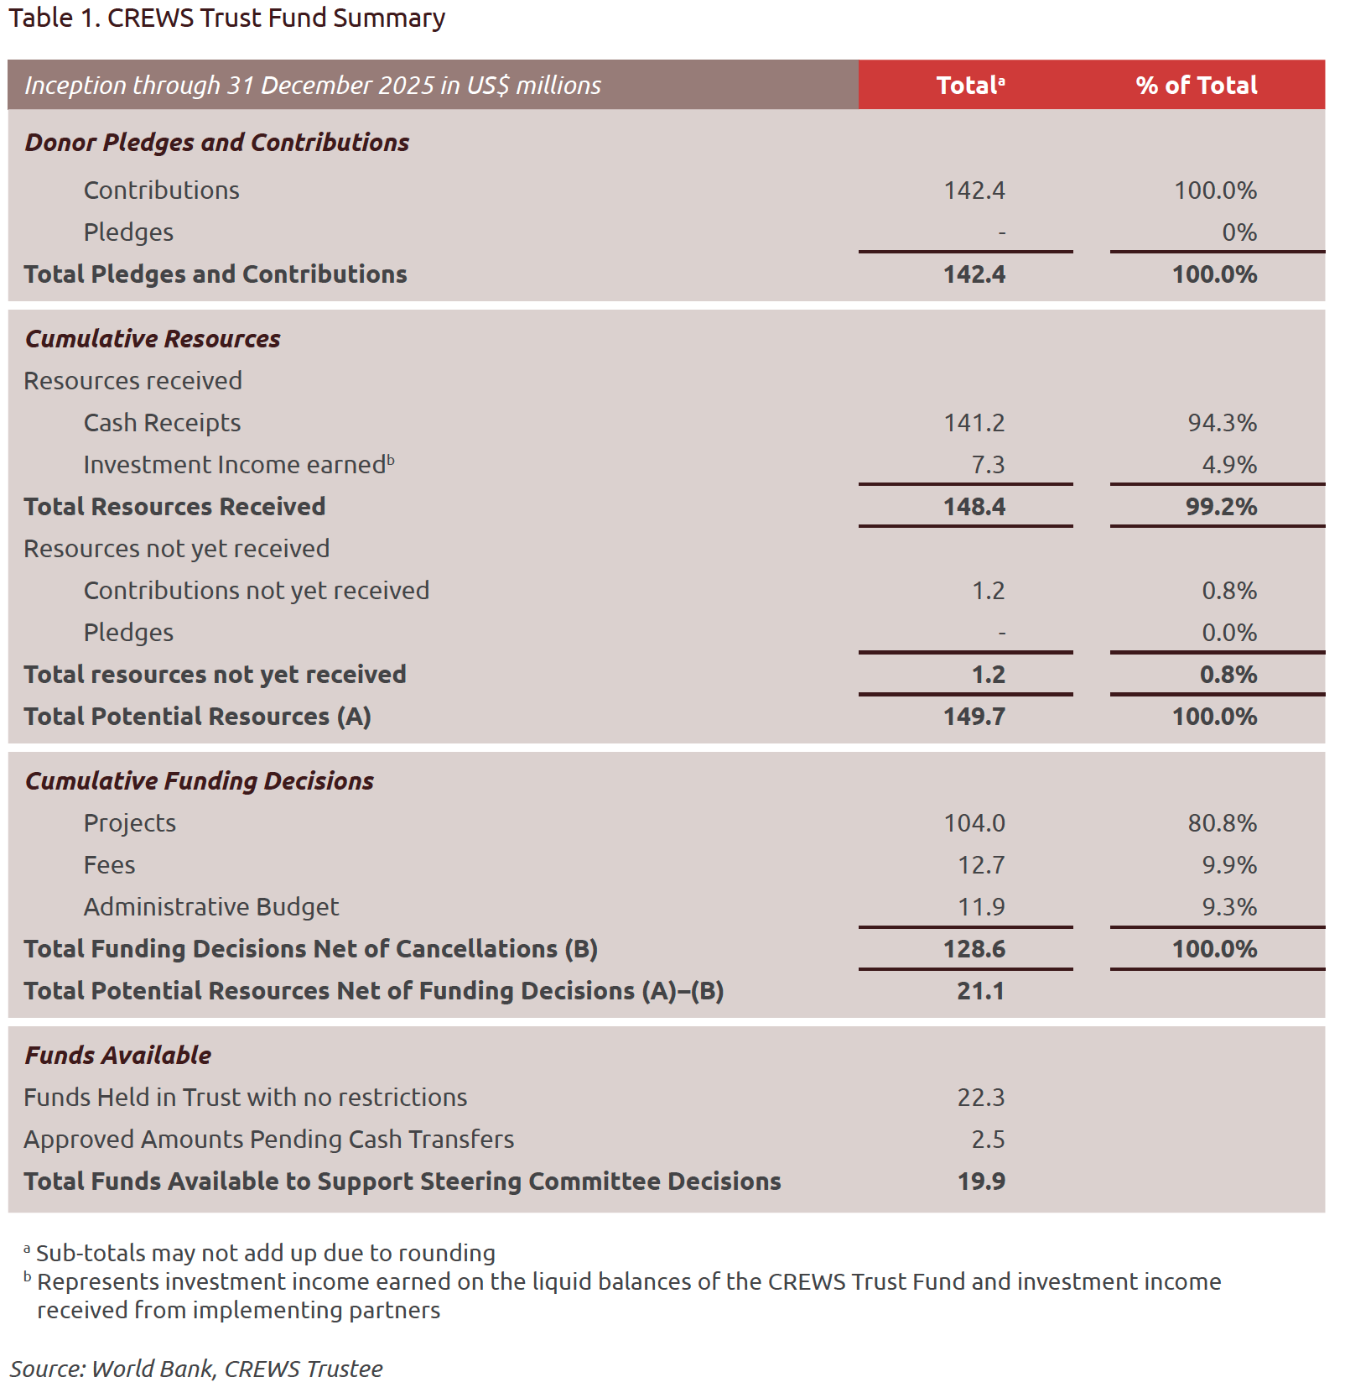
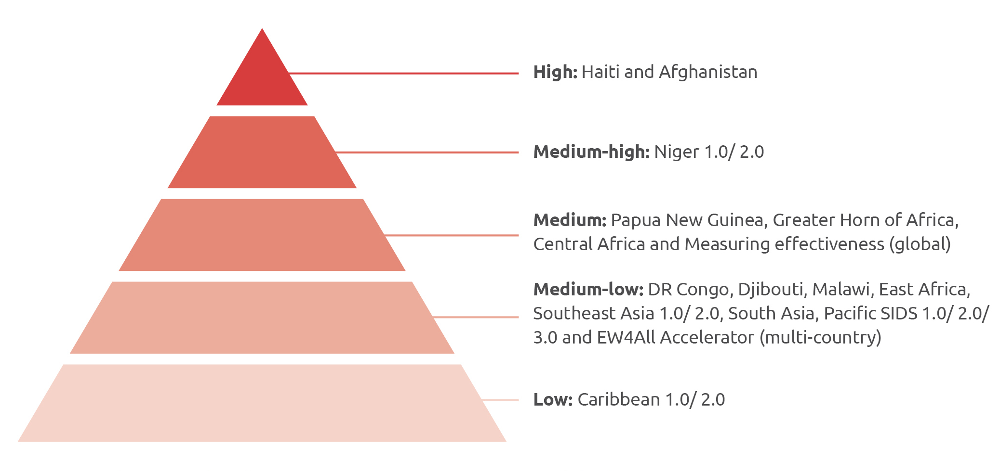
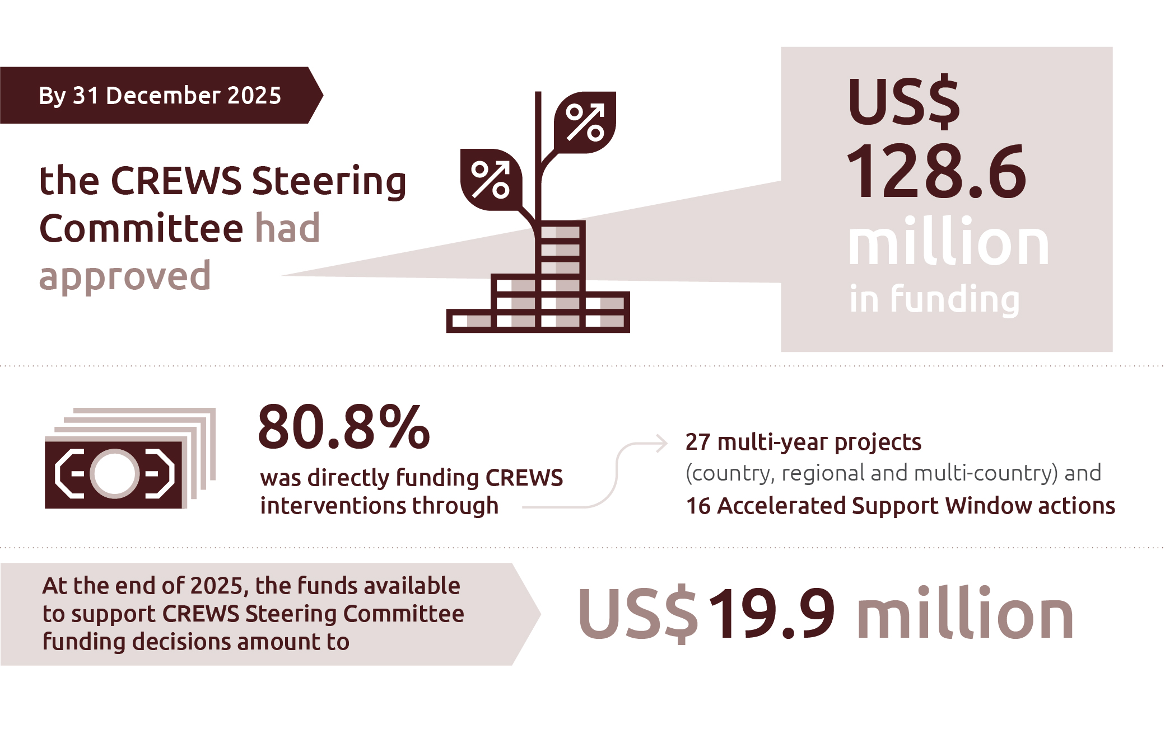
Risk and financial management

Slide 10
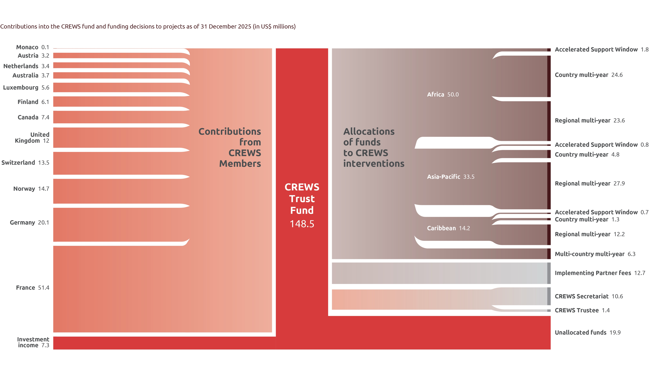

Slide 11
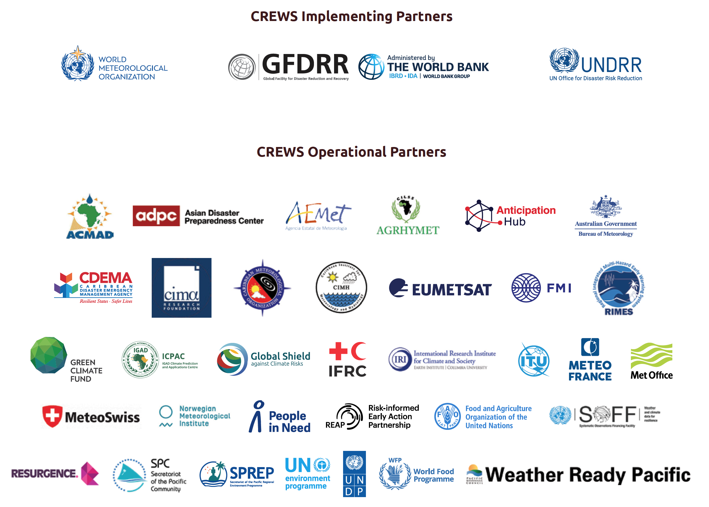
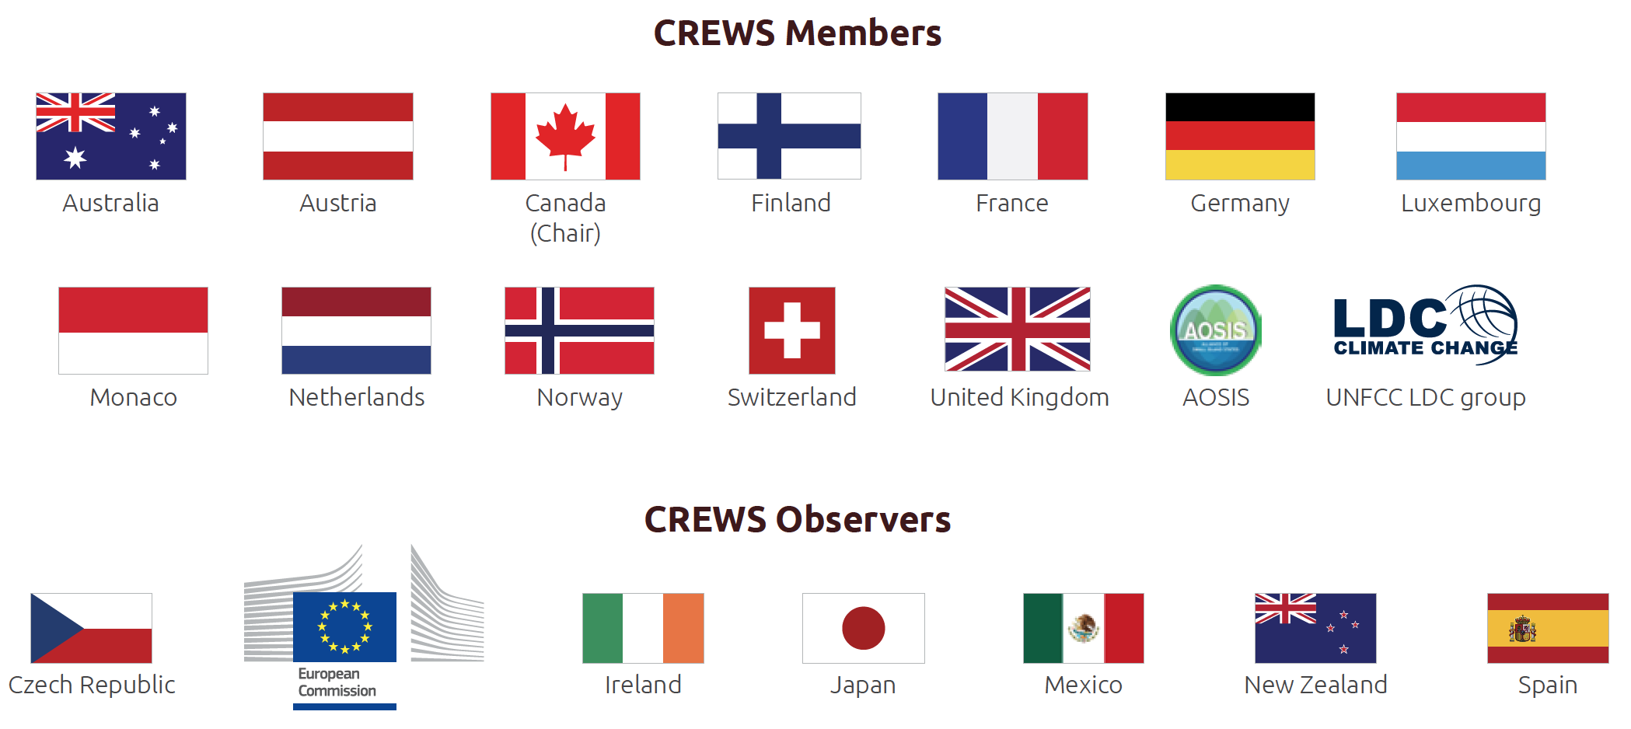
A decade of delivery sets strong foundations for the future
Consolidating on a decade of delivery
Catalysing future investment
Initiating new projects and new opportunities
Setting countries on a pathway to investment
A strong foundation for the future
All made possible by:

Slide 12

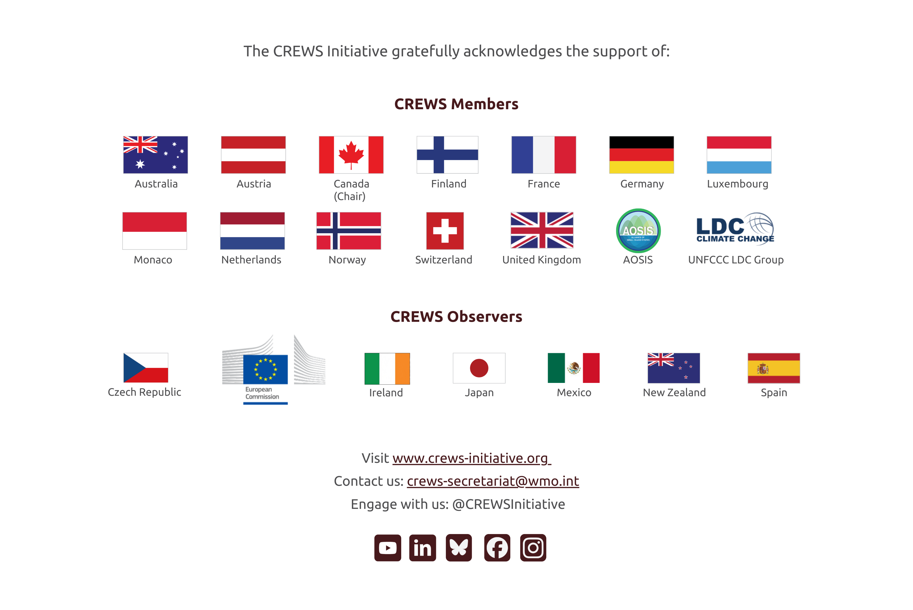
Thank You

