Slide 1
Climate Risk & Early Warning Systems
Joint Reporting on Status of CREWS Portfolio from
January – June 2020
CREWS/SC.11/infdoc.6
11th CREWS Steering Committee Meeting 10 June 2020
Australia
France
Germany
Luxembourg (Chair)
Netherlands
Switzerland
United Kingdom

Slide 2
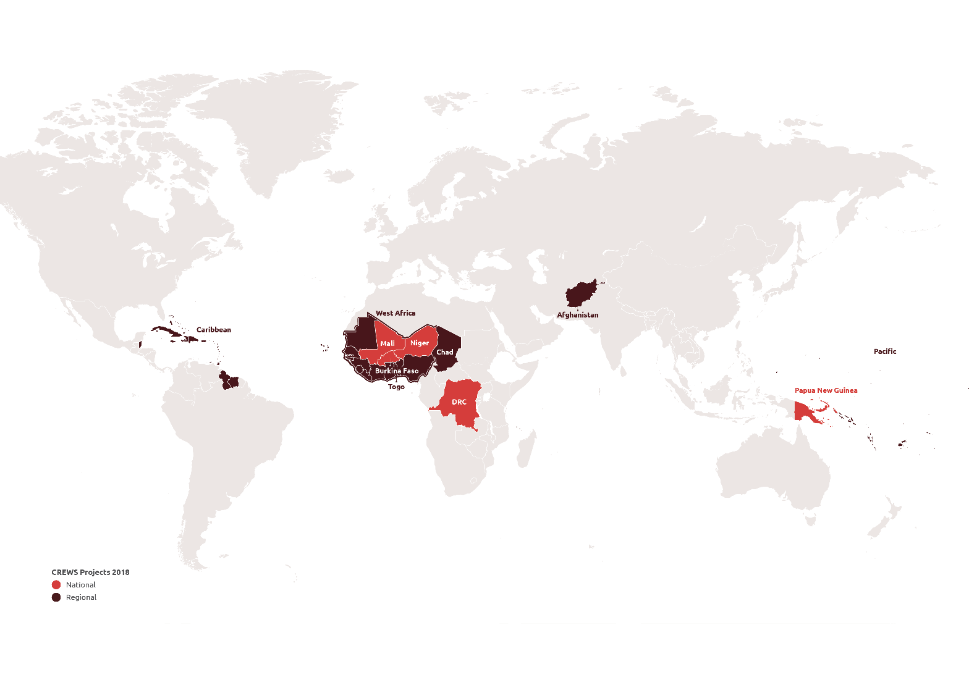
Content
FOR EACH REGION/COUNTRY:
Overview of the portfolio (country and regional projects)
Progress by output for reporting period
Project performance
status
Project risk status

Slide 3
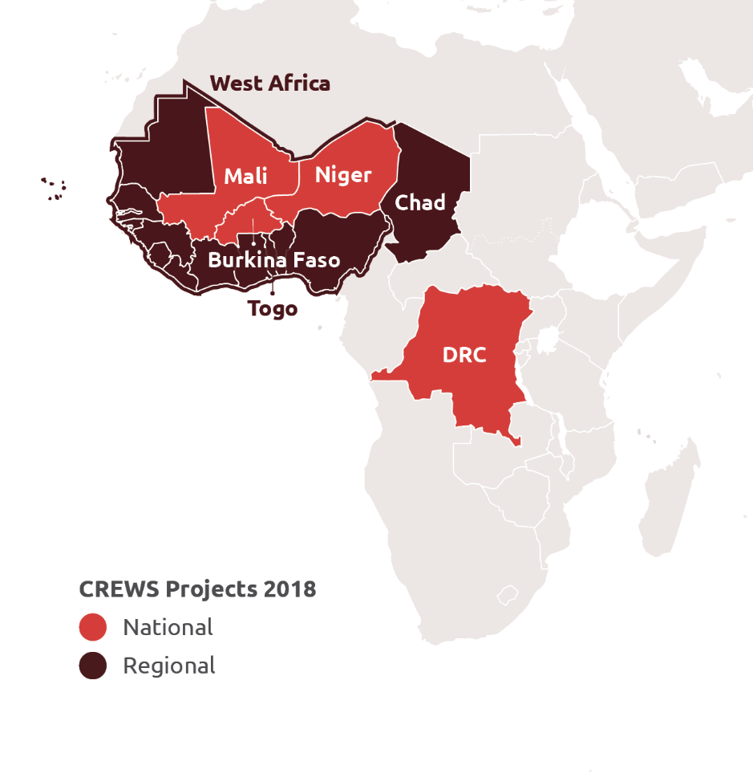
Leveraging
AFRICA
Project | In USD | Leveraging and synergies (in USD) | Leveraging factor
Burkina Faso | 2,192,200 (WMO) | GCF 22 million / IDA 9 million / GFCS 300k / GEF 3.6 million / CREWS West Africa | 16x
Chad | 3,150,000 (WB, WMO) | IDA TBD / CREWS West Africa | TBD
Democratic Republic of the Congo | 3,090,000 (WB, WMO) | GFDRR 2.7 million / GEF 5.2 million / WB DRM Urban | 2.5x
Mali | 3,333,000 (WB, WMO) | GCF 23 million / IDA 8 million | 9x
Niger | 2,740,000 (WB, WMO) | AfDB Met 13 million / WB EWS Hydro 20 million / CREWS West Africa | 12x
Togo | 2,365,000 | IDA TBD | TBD
West Africa (regional) | 1,834,555 (WMO) | IDA TBD / ACP-EU 8 million | 4x
Notes:
In addition to this map:
Chad, Sierra Leone and Togo are also receiving specific CREWS support
SWIO (Comoros, Madagascar, Mauritius, Mozambique, Seychelles) is pipeline

Slide 4
Progress by Output
Training on crop-calendars and R-Instat for crop monitoring and food security warning held with participants from countries in the region – Burkina Faso, Mali, Niger, Chad, Togo
In Niger, 600 women were trained on Early Warning and Disaster Risk Management and in Burkina Faso, conduct of gender-informed analysis ongoing.
1
SERVICE DELIVERY
6
GENDER
Assessments of opportunities for sustainable operation of observing networks and hydrological and climate databases conducted in Chad, DRC and Togo
5
KNOWLEDGE PRODUCTS
2
RISK INFORMATION
In DRC, progress in establishing the National Framework for Climate Services (NFCS) and development of national risk geoportal for flood risk assessment and forecasting
In Niger, knowledge dissemination activities on the National Alert Code conducted for local authorities, departments and local communities
4
PREPAREDNESS AND RESPONSE
3
ICT
In Chad and DRC, proposals for data concentration with free and open EUMETSAT DCP system developed

Slide 5
Project Performance

Slide 6
Burkina Faso:
Rate of expenditure – approx. $1.3 million (62%) spent and an additional $ 641,460 (29%) committed.
Rate of delivery - Draft independent mid-term review identifies a mix of activities delivered as well as some unexpected delays. Overall, delivery is on track and all outputs are expected to be achieved by the end of the project.
The objectives of the program are consistent with (i) national policies and strategies, donor policies, and initiatives of other major donors; (ii) overall purpose and objectives defined during project formulation. The adopted approach, particularly for the capacity building of ANAM, has demonstrated to be well adapted to the context.
.
Chad:
i. Rate of expenditure at approx. $68,388 (2%) and commitment of $336,810 (11%).
ii. Rate of delivery: After the project was officially launched in September 2019 during a joint WB/WMO mission, initial activities were engaged. However, progress came to a halt as the entire world copes with COVID19 pandemic. The partnership with the Met Agency ANAM was made official and an agreement was reached on the set of implementation activities.
iii. No change has been made to the design of the project, which remains relevant for the Country and fully aligned with both the World Bank Strategy and the National Development Plan.

Slide 7
Democratic Republic of Congo:
i. Rate of expenditure is $874,841 (28%) and commitment at $45,185 (1%) expected to improve with the increasing activities postponed due to COVID-19.
ii. Rate of delivery is currently low as a result of impacted by the COVID-19.
iii. The implementation of activities is adversely impacted by the COVID-19.
Mali:
i. Rate of expenditure is approx. $ 1,093,899 (33%) and commitment at $503,648 (15%).
ii. Rate of delivery saw some activities planned delayed due to Covid-19. Nevertheless, CREWS implementation is continuing especially activities linked to the Hydromet Investment project.
iii. Fully aligned on the EWS objectives as well as the country development priority.

Slide 8
Niger:
i. Rate of expenditure is $1,417,151 (52%) and $16,963 (1%) in commitments
ii. Rate of delivery saw postponement of certain activities due to COVID-19.
iii. Fully aligned on the EWS objectives as well as the country development priority.
Togo:
Rate of expenditure - No major expenses have been posted despite the fact that several preparatory engagements have taken place.
Rate of delivery - The project started well, but due to the health crisis linked to COVID19 pandemic, the implementation of several activities is experiencing delays.
The CREWS project is fully aligned with the EWS objectives as well as the country development priority highlighted in the National Development Plan covering the period 2018-2022.

Slide 9
West Africa
i. Rate of expenditure – Approx. $954,782 (52%) and approx. $ 674,000 (37%) committed against the initial approved allocation
ii. Rate of delivery – On track in terms of progress
iii. Project remains strongly aligned to the initial objectives, and recent developments with 2 new countries supported by CREWS (Chad, Togo) are even providing a stronger justification for supporting regional cooperation with this regional project.

Slide 10
Risk Status
Burkina Faso: Medium/Moderate
Risk remaining of suboptimal use of resources within DEIE, and lack of staff
Security risks in the country have deteriorated over the past 18 months, and French civil servants are no longer able to travel in Ouagadougou.
Mitigation:
an amendment to the Letter of Agreement with ANAM was signed, allowing ANAM to implement activities in support of DEI and a coordination meeting was held with the Hydromet project
trainings, missions and workshops have been relocated from Ouagadougou to Toulouse and Niamey, or have been postponed.
Chad: Medium/Moderate
Due to the challenges related to COVID-19 the Task Teams are currently unable to travel and activities are limited
Mitigation: Assessing the proposed project’s activities to determine which of these could still be carried out in the current context and will also explore remote connectivity opportunities to work with the Chadian counterparts

Slide 11
Democratic Republic of Congo: Medium/Moderate
Mitigation:
Closer monitoring during the COVID and Post COVID eras is envisaged to ensure the delivery of activities.
In relation to the low capacity of Mettelsat, the World Bank, WMO and a number of international and local experts are all involved to support the delivery of activities.
Mali: Medium/Moderate
Increased insecurity in Mali mainly in the center, southern and northern parts of the country
Increased health risk due to the current global Public Health threat (COVID 19) which is delaying some activities implementation.
Mitigation measures include:
(i) Increase national implementing capacity to work remotely;
(ii) Planning for securing equipment and ICT tools are being developed to facilitate remote M&E.
(iii) Support capacity building in training and awareness campaign in southern secured areas.
(iv) Support for awareness campaigns on how to prevent COVID 19 pandemics

Slide 12
Niger: Medium/Moderate
COVID-19 situation delayed implementation.
Mitigation: Consider extending the closure date to 2021 in order to align with IDA investment additional financing to continue support the country EWS.
Togo: Medium/Moderate
CREWS activities are slowed down by COVID-19.
Heavy rains of March followed by strong winds caused the destruction of several school buildings leading to fatalities in particular in Kpessi in the northern country.
Mitigation:
provided credits for communications and Internet to all the stakeholders
necessary to update the National Contingency Plan and the ORSEC Plan
support capacity building in training and awareness campaign in selected areas with high level of hazards.

Slide 13
West Africa:: Medium/Moderate
Mitigation measures:
online consultations with AGRHYMET, such as (i) PRESASS (April), (ii) consultations with partners (DWD, UoR, IRI), and (iii) cooperation agreement between ANACIM, AGRHYMET and WMO (draft, June 2020);
transfer of knowledge to AGRHYMET (Niamey) and ANACIM (Dakar) to ensure sustainability of project outputs after project completion;
upscaling the project from 1.8 million USD to 5.3 million USD (approved by CREWS SC on 28 Feb 2020).

Slide 14
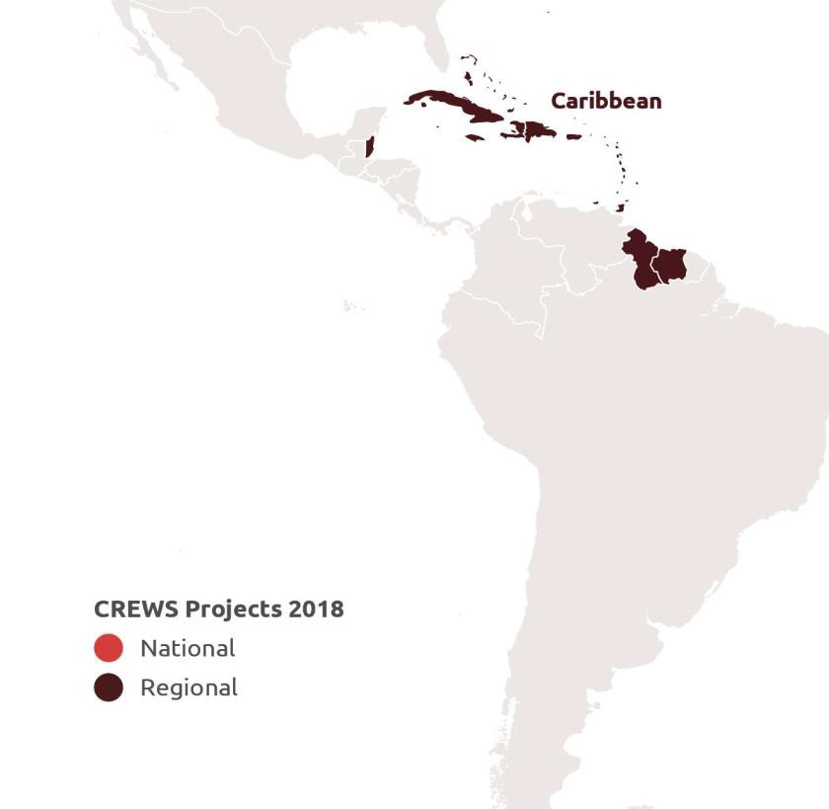
Leveraging
CARIBBEAN
Project | In USD | Leveraging and synergies | Leveraging factor
Caribbean Regional (CARICOM) | 5,500,000 (WB, WMO, UNDRR) | Building seamless multi- hazard early warning under the CREWS Initiative (Environment and Climate Change Canada) (CAD 2,000,000 for the Caribbean) | 0.36x

Slide 15
Progress by Output
Recommendations from the 4 nat’l workshops on needs of gender and vulnerable groups in EWS were considered in the strategy
6
GENDER
1
SERVICE DELIVERY
Finalized the situation analysis of the draft Regional Strategy
Online IBF knowledge sharing activity held in May with 98 participants from hydrometeorological, DRR, private sector and expert stakeholders.
5
KNOWLEDGE PRODUCTS
2
RISK INFORMATION
No activities to report during this period.
An implementation Arrangement with CDEMA is going through WMO’s internal approval process that seeks to strengthen Preparedness & Response plans with a focus on SOPS
4
PREPAREDNESS AND RESPONSE
3
ICT
CMO preparatory work with the identified countries for roll-out of the development process for the National Strategic Plans
Notes:
Slide 15 – Caribbean progress by outputs
One of the key achievements the last few months is the 4-day virtual Impact-based forecasting and risk scenario workshop for the Hydromet & Disaster Management communities, inclusive of gender bureaus and the private sector generated a number of quick wins, including greater involvement of practitioners in all communities, an increased appetite to better understand and support the initiative, and greater visibility for CREWS and its partners. 18 countries were represented, with 93 people, 25% of which were women, including heads of the NDMOs of Barbados & St. Vincent & the Grenadines; and Caribbean Met Organization.
CMO is working with the CARICOM (Caribbean Community) Office of Legal Counsel as well as the Organization of Eastern Caribbean States (OECS) to develop a template Meteorological Bill expected to be adapted two countries; The ToRs have been finalized and a call for an Expression of Interest has been issued.
Finalisation of the ToR develop 8 (NS-FWCS) and their Action Plans is on-going for 8 countries (including Anguilla, Antigua and Barbuda, Dominica, Grenada, Guyana, Jamaica, St. Kitts and Nevis, St Vincent and the Grenadines)
There is also continued support for the Caribbean Climate Outlook Forum (CariCOF) - a face to face wet season CariCOF was originally planned to take place in Saint Lucia – but this was re-scaled and conducted virtually last month.
(ASK DONNA – do we have complementary info on CARICOF)
An agreement with CDEMA which seeks to strengthen preparedness and response plans should be in place shortly.
The implementation of a River Flood Forecasting System (RFFS) in Hispaniola, coupled with the Haiti Dominican Republic Flash Flood Guidance System and the Coastal Inundation Forecasting Project in the is continuing as planned. Two new partners, Brigham Young University (BYU) and the National Institute of Hydraulic Resources (INDRHI), have been engaged to assist in developing the system and carrying out a series of trainings and capacity building activities.
While we are in the Caribbean (and even though it is not on the presentation) – would like to provide an update on the Haiti project, the funds for which were received 1st of May.
We have held several discussions with the colleagues from the World Bank concretizing deliverables/achievements from other donor funded projects to ensure results (and lessons learnt) will be factored into priority activities for CREWS Haiti.
Priorities agreed to under the nearly finalized National Strategic, funded by the Canada Haiti project, and outputs of the consultations with the WB will inform the Project kick-off meeting - being planned for July/August (a virtual meeting as we do not anticipate any opening up of borders or vast improvement in local situation). The goal of the meeting is to develop a comprehensive implementation plan, in collaboration with international, regional and national partners.
These efforts are supported by a local hire who is also funded through the Canada project.

Slide 16
Project Performance
Caribbean Regional:
i. Rate of expenditure is on track with US$ 1,596,897 (29%) being expended, and commitments for $160,114 (3%).
ii. Rate of delivery - While the rate of delivery is on track in most aspects, the development of the regional situation analysis and strategy experienced some delays.
iii. The project remains strongly aligned to the objectives.

Slide 17
Risk Status
Risk Rating: High as the COVID-19 crisis continues to unfold in the Caribbean
Limited ability to participate in CREWS activities by regional stakeholders, as Caribbean Disaster Emergency Management Agency (CDEMA) and Caribbean Public Health Agency (CARPHA) due to responses to COVID-19.
Several important regional events were consultation on the situation analysis and strategy were intended have been canceled.
Mitigation: Implementing Partners have decided to continue the technical work for the development of the regional strategy with the project's team of experts and to limit the exchanges with the regional partners until more favorable moments.
Notes:
Delays were experienced in executing several planned face to face meetings and workshops; including the engagement of experts to develop NSPs and Met Bills.
Some workshops, as previously mentioned (CariCOF and IBF workshop), have been re-scaled and delivered via virtual platforms

Slide 18
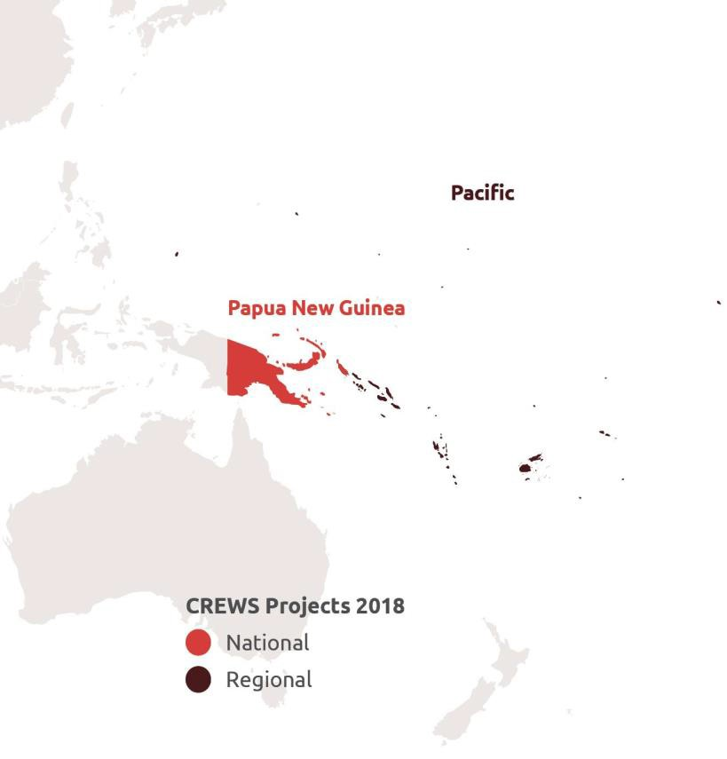
Leveraging
PACIFIC
Project | In USD | Leveraging and synergies (in USD) | Leveraging factor
Pacific | 2,500,000 (WMO) | Canada-CREWS 2.5 million + WB Pacific resilience program (Samoa 14 million, Tonga 15 million, Marshall Island 20 million) + Australia Climate and Oceans Support Program in the Pacific (COSPPac) 16 million. GCF Projects. | 27x
Papua New Guinea | 1,650,000 (WMO) | BoM Climate and Oceans Support Program in the Pacific (COSPPac) + Australia 600,000 | 0.36x

Slide 19
Progress by Output
Tuvalu Strategic Plan approved and meteorological bill finalized and ready for presentation to Parliament; Agreement signed with New Zealand Met Service for in-country Severe Weather Forecast and DRR project on forecasting and warning services for severe weather in 10 Pacific SIDS
No activities were planned during the reporting period
6
GENDER
1
SERVICE DELIVERY
In PNG, a set of selected WMO SEMDP products were produced to aid in the preparation of operational drought information; 6th Pacific Islands Climate Outlook Forum (PICOF-6) held in April 2020
5
KNOWLEDGE PRODUCTS
2
RISK INFORMATION
Hazard assessments in Tuvalu, Kiribati completed and data analysed; In PNG, issued 1st seasonal forecast incorporating ACCESS-S
Consultations and workshops have been completed in RMI, Niue and Palau on community-based early warning services (CBEWS);
4
PREPAREDNESS AND RESPONSE
3
ICT
Remote installation of the FFGS and IT training ongoing; website designs completed for Tuvalu, Kiribati and Nauru
Notes:
Papua New Guinea
The procurement of computer equipment and vehicle has started.
These remote sensing products from the WMO Space-based Weather & Climate Extreme Monitoring Demonstration Project were introduced to stakeholders in PNG and include satellite-based precipitation estimates and several drought indices.
The PNG National Weather Service has also issued its first seasonal forecast incorporating BoM climate model (ACCESS-S).
In the Pacific:
Tuvalu: The national strategic plan has been endorsed by the met service; their Meteorological Bill is now ready for presentation to Parliament
Kiribati: the development of National Strategic Plan and Framework for Weather and Climate Services is ongoing
Fiji: procurement of the HPC servers for RSMC Nadi has been completed, they are expected to be delivered shortly (training is pending due to travel restrictions)
Training on the radar data ingestion for Fiji FFGS is on-going but was delayed due to COVID-19
The Agreement with Met Service New Zealand to provide 10 in-country training on Severe Weather Forecasting has been finalized and is expected to start as soon as travel restrictions are lifted. (10 countries Cook Islands, Fiji, Kiribati, Niue, Samoa, Solomon Islands, Tuvalu, Tonga, Vanuatu, and Nauru)
The Agreement with the Asian Disaster Preparedness Centre (ADPC) to conduct MHEWS assessments in the Cook Islands, Fiji, Kiribati, Nauru, Niue, Tokelau, and Tuvalu is in place. Remote consultations and desk studies are on-going.

Slide 20
Project Performance
Pacific Regional Project
The rate of expenditure is on track with a total expenditure of USD 1,857,466 (74%) from the CREWS Contribution.
Overall, project delivery has progressed according to plans with some delays. These delays are a direct result of the international travel bans and national restrictions on movement and gathering of people.
The project remains strongly aligned to the objectives.

Slide 21
Project Performance in PNG
Rate of expenditure – Disbursement rate is at 29% or US$ 478,000 of the approved total of US$ 1,650,000 funding.
Rate of delivery – With 2 full-time staff and engagement of specialized experts from BoM and PNGNWS, rate of delivery is on track.
The project remains strongly aligned to the CREWS objectives.

Slide 22
Risk Status
Pacific Regional: The overall risk is low, nevertheless, the current COVID-19 pandemic is increasing the risk for delays in project implementation to medium/high.
Mitigation:
close cooperation and regular consultations with the implementing partners SPC, SPREP, MetService New Zealand, HRC and ADPC, and coordination and regular consultations between the beneficiary NMHSs and WMO
WMO together with partners are continuing the dialogue remotely and identify alternative solutions where appropriate.
PNG: Medium/Moderate
Mitigation:
Support received from BoM and the Government of Australia through the PNG Capacity Development project
Notes:
Pacific:
COVID-19 and related travel restrictions are causing significant delay in the implementation of activities:
Impact-based coastal inundation forecasting in Tuvalu and Kiribati: SPC is not able to travel to install the wave buoys procured in the previous reporting period, nor carry out the necessary capacity building. Field work to establish baseline data including land elevation originally scheduled for March 2020 is still pending.
SPREP community based EWS: Travel restrictions are delaying the implementation of the project, including the jump-start workshop in Federated States of Micronesia. The planned IT workshop is also on hold until travel restrictions are lifted
National Impact-based forecasting workshop in Solomon Islands: postponed from June until October 2020. Pending lift of travel restrictions.
PNG:
COVID-19 has caused some delays. 3rd CREWS-PNG workshop tentatively planned to be held in Port Moresby, PNG in May 2020 but due to impact of the COVID-19, this workshop and subsequent consultations / training postponed for 6 months. However, fortnightly virtual meeting of project partners has commenced. Rate of delivery should be changed to medium (yellow) due to COVID-19. However, the weather and climate modeling being done by BoM has continued.

Slide 23
Afghanistan
Leveraging
Project | In USD | Leveraging and synergies | Leveraging factor
Afghanistan | 3,665,000 (WB, WMO) | USD 2M - World Bank/DFID Programme on Asia Resilience to Climate Change Trust Fund (PARCC). Irrigation Restoration and Development Project 22,800,000 (WB) | 8.4x

Slide 24
Progress by Output
Commenced preparatory activities for the preparation of the Hydromet Concept of Operations, Service delivery strategy and legal & institutional framework
Drafted training needs for the Drought Early Warning System
6
GENDER
1
SERVICE DELIVERY
TOR developed and firm contracted for the development of the Afghanistan Hydromet Atlas
5
KNOWLEDGE PRODUCTS
2
RISK INFORMATION
Drafting of technical brief for the design of the Drought Early Warning System and concept for FFGS
Initiated the preparation of a detailed plan for capacity assessment and training plan
4
PREPAREDNESS AND RESPONSE
3
ICT
Initiated the drafting of the guidance document for the modern impact-based weather forecasting process

Slide 25
Project Performance
Rate of expenditure – $61,309 (2%) expenditure ; Commitments at $170,842 (5%) made but disbursements delayed due to COVID
Rate of delivery – Efforts ongoing to conduct virtual training to continue implementation of activities despite COVID
The project remains fully aligned to the CREWS objectives.

Slide 26
Risk Status
Risk Rating: High
Due to added constraints of the COVID situation
Mitigation: Conduct of virtual communications and meetings

Slide 27
Thank you

